Slide 1

PERSONAL PORTFOLIO WEBSITE at UNITED COLLEGE OF ENGINEERING AND RESEARCH
NAME : VISHAL TIWARI
UNIVERSITY ROLL NO:2200100100390

Slide 2

Topics Covered
INTRODUCTION
METHODOLOGY
ER DIAGRAM
SNAPSHOTS
LIMITATIONS
REFERENCES

Slide 3
Introduction
Salary prediction is a crucial task for job seekers, HR professionals and Organizations.
This project applies Machine Learning models to predict salaries based on various factors includes.
Factors include Education, Experience, Job role, Industry, Location, Company Size, and more….

Slide 4
Methodology
Data Collection: Used salary_train.csv with features — Education, Experience, Job Title, Industry, Location, and Salary.
Preprocessing: Handled missing values (SimpleImputer), scaled numericals (StandardScaler), encoded categoricals (OneHotEncoder), and merged using ColumnTransformer + Pipeline.
Model Development: Trained Random Forest and Gradient Boosting models; combined via Voting Regressor for better accuracy. Data split — 80% train / 20% test.
Evaluation: MAE: ₹6,436.73 | R²: 0.6991 (~70% accuracy).
GUI Integration: Built Tkinter desktop app for instant salary prediction; model saved as Pickle (.pkl) for reuse

Slide 5
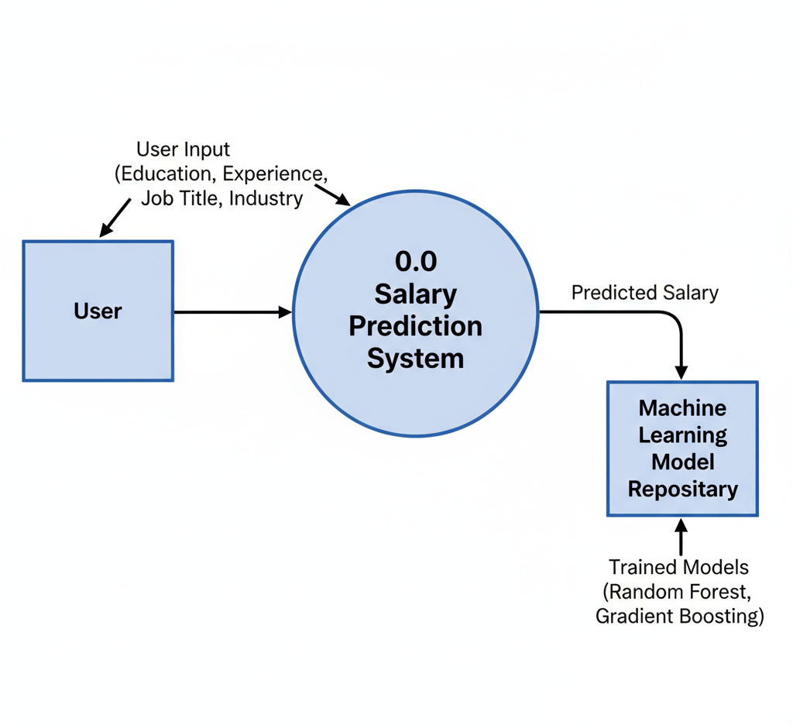
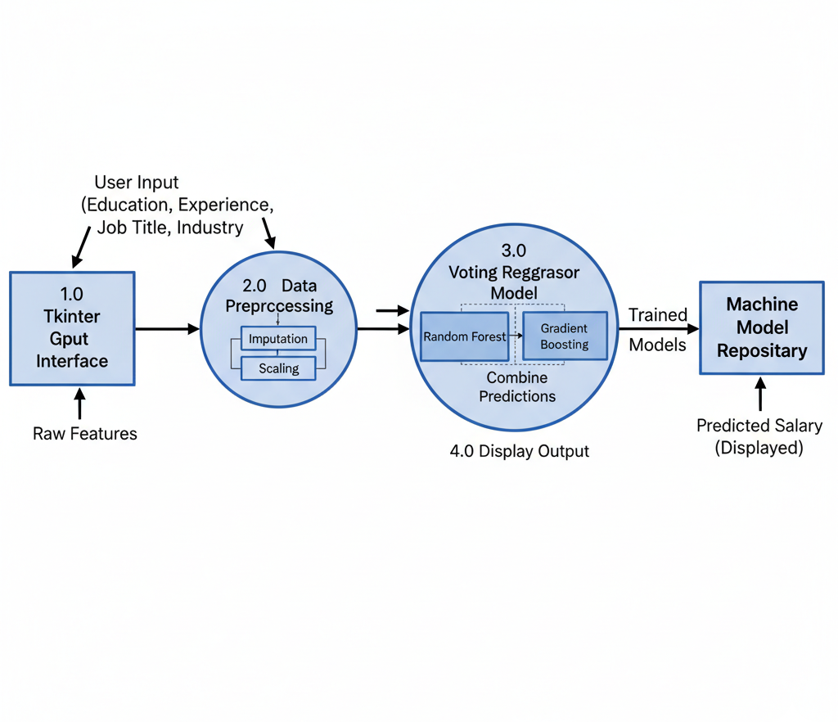
ER Diagram/ DFD
LEVEL-0 DFD
LEVEL-1 DFD

Slide 6
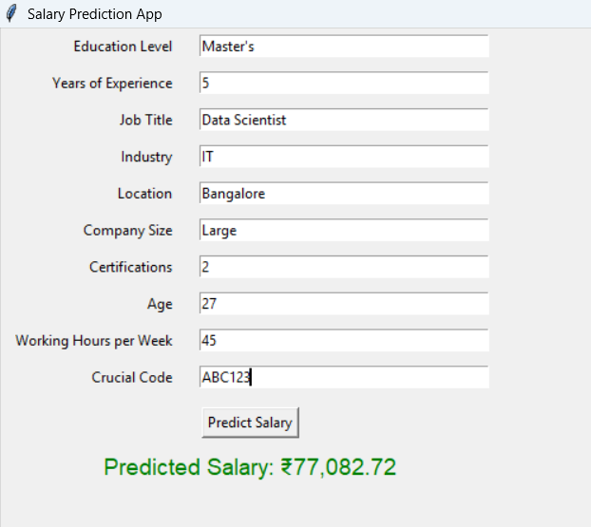
Results / Snapshots

Slide 7
Limitations
The model’s accuracy (R² ≈ 0.69) depends on the quality and size of the training dataset
.
Outdated or biased data can lead to unrealistic salary predictions.
Limited feature coverage — some factors like company reputation, job performance, and negotiation skills are not included.
Tkinter GUI is desktop-based; not accessible through web or mobile platforms.
Model performance may vary for unseen job roles or rare combinations of inputs.
Predictions are approximate and should not be used for real salary decisions without further validation

Slide 8
Future Scope
Add advanced ML models like XGBoost, CatBoost, or Neural Networks to improve prediction accuracy.
Develop a web or mobile app version using Flask or Streamlit for wider accessibility.
Integrate live data APIs (e.g., LinkedIn, Glassdoor) for up-to-date salary insights.
Include more features such as company reputation, skills, performance ratings, and location cost index.
Implement visualization dashboards to show salary trends, distributions, and insights.
Expand dataset size with real-world salary data from multiple industries for better generalization.
Deploy on cloud platforms (AWS, Google Cloud, or Azure) for scalability and real-time use

Slide 9
References
Scikit-Learn Documentation — https://scikit-learn.org
Pandas Library — https://pandas.pydata.org
Tkinter GUI Documentation — https://docs.python.org/3/library/tkinter.html
Dataset Source — Custom/Academic salary dataset (salary_train.csv)
Ensemble Learning Techniques — Research papers and tutorials on Random Forest, Gradient Boosting, and Voting Regressor
Medium & Kaggle Articles on Salary Prediction and ML Regression Projects

